Slide 1
Session 34 : Data storage
using File system
Module 4.3 : Android

Slide 2
Learning Objectives
At the end of the session successful participants will be able to
Understand need of External Storage
Check State of External Storage
Work with Files in External Storage
Shipping Files with the Application
Work with Raw Resource Files
Work with Asset Files

Slide 3
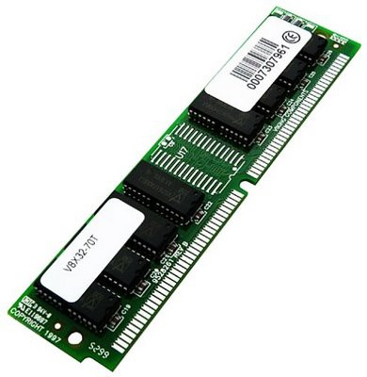
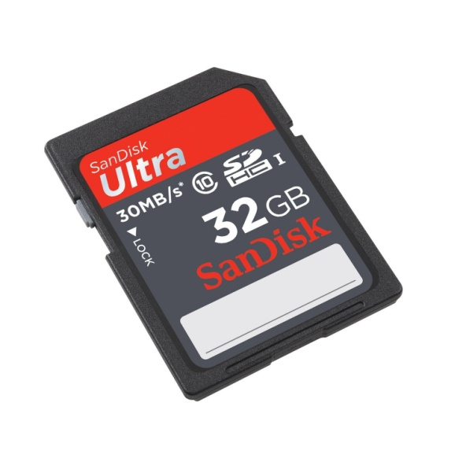
Android Persistency - Files
Android Files
Android uses the same file constructions found in a typical Java application.
Files can be stored in the device’s (small) main memory or in the much larger SD card. They can also be obtained from the network (as we will see later).

Slide 4
Android Persistency - Files
Android Files
Android uses the same file constructions found in a typical Java application.
Files stored in the device’s memory, stay together with other application’s resources (such as icons, pictures, music, …).
We will call this type: Resource Files.

Slide 5
Android Persistency - Files
Android Files
Your data storage options are the following:
Shared Preferences
Store private primitive data in key-value pairs.
Internal Storage
Store private data on the device memory.
External Storage
Store public data on the shared external storage.

Slide 6
Android Persistency - Files
Android Files
Your data storage options are the following:
SQLite Databases
Store structured data in a private database.
Network Connection
Store data on the web with your own network server.

Slide 7
Android Persistency - Files
Android Files
Your data storage options are the following:
SQLite Databases
Store structured data in a private database.
Network Connection
Store data on the web with your own network server.

Slide 8
Android Persistency - Files
Android Files
Shared Preferences
Good for a few items saved as <Name, Value>
privatevoidusingPreferences(){
// Save data in a SharedPreferencescontainer
// We need an Editor object to make preference changes.
SharedPreferencessettings = getSharedPreferences("my_preferred_Choices",
Context.MODE_PRIVATE);
SharedPreferences.Editoreditor = settings.edit();
editor.putString("favorite_color", "#ff0000ff");
editor.putInt("favorite_number", 101);
editor.commit();

Slide 9
Android Persistency - Files
Android Files
Shared Preferences
Good for a few items saved as <Name, Value>
// retrieving data from SharedPreferencescontainer
String favColor= settings.getString("favorite_color", "default black");
intfavNumber= settings.getInt("favorite_number", 0);
Toast.makeText(this, favColor+ " "+ favNumber, 1).show();
}

Slide 10
Android Persistency - Files
Android Files
Internal Storage.
Using Android Resource Files
When an application’s .apk byte code is deployed it may store in memory: code, draw-ables, and other raw resources (such as files). Acquiring those resources could be done using a statement such as:
InputStreamis = this.getResources().openRawResource(R.drawable.my_base_data);

Slide 11
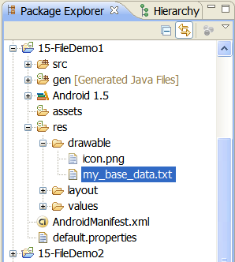
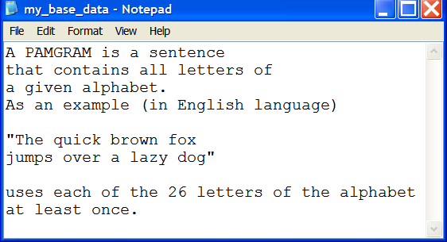
Android Persistency - Files
Android Files
Internal Storage.
Using Android Resource Files
Use drag/drop to place file my_base_data.txt in res folder. It will be stored in the device’s memory as part of the .apk

Slide 12
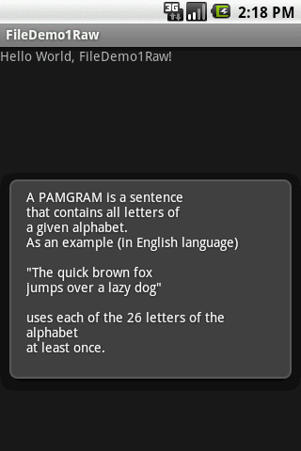
Android Persistency - Files
Android Files
Example 1
Reading a Resource File (see previous figure)
//reading an embedded RAW data file
packagecis493.files;
importandroid.app.Activity;
importandroid.os.Bundle;
importandroid.widget.Toast;
importjava.io.*;
publicclassFileDemo1Raw extendsActivity { @Override
publicvoidonCreate(Bundle savedInstanceState) {
super.onCreate(savedInstanceState);
setContentView(R.layout.main);

Slide 13
Android Persistency - Files
Android Files
Example 1
Reading a Resource File (see previous figure)
try{
PlayWithRawFiles();
} catch(IOExceptione) {
Toast.makeText(getApplicationContext(),
"Problems: "+ e.getMessage(), 1).show();
}
}// onCreate

Slide 14
Android Persistency - Files
Android Files
Example 2
Reading a Resource File (see previous figure)
publicvoidPlayWithRawFiles() throwsIOException{
String str="";
StringBufferbuf= newStringBuffer();
InputStreamis = this.getResources()
.openRawResource(R.drawable.my_base_data);
BufferedReaderreader = newBufferedReader(
newInputStreamReader(is));
if(is!=null) {
while((str= reader.readLine()) != null) {
buf.append(str+ "\n");}}
is.close();
Toast.makeText(getBaseContext(),

Slide 15
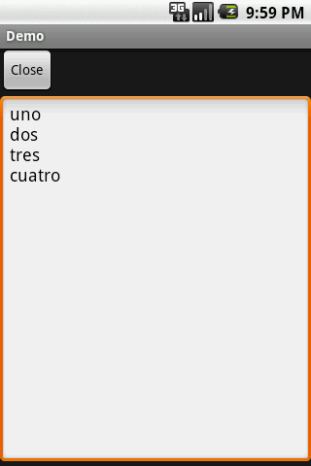
Android Persistency - Files
Android Files
Example 3 - Internal Storage
Read/Write an Internal File
In this example an application collects data from the UI and saves it to a persistent data file into the (limited) internal Android System Space area.

Slide 16
Android Persistency - Files
Android Files
Example 3 - Internal Storage
Read/Write an Internal File
Next time the application is executed the
Resource file is read and its data is shown
in the UI

Slide 17
Android Persistency - Files
Android Files
Example 3 - Internal Storage
Grab from screen, save to file, retrieve from file
<?xml version="1.0" encoding="utf-8"?>
<LinearLayoutxmlns:android="http://schemas.android.com/apk/res/android"
android:layout_width="fill_parent"
android:layout_height="fill_parent"
android:orientation="vertical">
<Button android:id="@+id/close"
android:layout_width="wrap_content"
android:layout_height="wrap_content"
android:text="Close" />

Slide 18
Android Persistency - Files
Android Files
Example 3 - Internal Storage
Grab from screen, save to file, retrieve from file
<EditText
android:id="@+id/editor"
android:layout_width="fill_parent"
android:layout_height="fill_parent"
android:singleLine="false"
android:gravity="top"
/>
</LinearLayout>

Slide 19
Android Persistency - Files
Android Files
Example 3 - Internal Storage
Grab from screen, save to file, retrieve from file
package cis493.demo;
import android.app.Activity;
import android.os.Bundle;
import android.view.View;
import android.widget.Button;
import android.widget.EditText;
import android.widget.Toast;
import java.io.BufferedReader;
import java.io.InputStream;
import java.io.InputStreamReader;
import java.io.OutputStreamWriter;

Slide 20
Android Persistency - Files
Android Files
Example 3 - Internal Storage
Grab from screen, save to file, retrieve from file
public class Demo extends Activity {
private final static String NOTES="notes.txt";
private EditText editor;
@Override
public void onCreate(Bundle icicle) {
super.onCreate(icicle);
setContentView(R.layout.main);
editor=(EditText)findViewById(R.id.editor);
Button btn=(Button)findViewById(R.id.close);
btn.setOnClickListener(newButton.OnClickListener() {
publicvoidonClick(View v) {

Slide 21
Android Persistency - Files
Android Files
Example 3 - Internal Storage
Grab from screen, save to file, retrieve from file
finish();
}
});
}//onCreate
public void onResume() {
super.onResume();
try{
InputStreamin=openFileInput(NOTES);
if(in!=null) {
InputStreamReadertmp=newInputStreamReader(in);
BufferedReaderreader=newBufferedReader(tmp);

Slide 22
Android Persistency - Files
Android Files
Example 3 - Internal Storage
Grab from screen, save to file, retrieve from file
String str;
StringBufferbuf=newStringBuffer();
while((str= reader.readLine()) != null) {
buf.append(str+"\n");
}
in.close();
editor.setText(buf.toString());
}//if
}
catch(java.io.FileNotFoundExceptione) {
// that's OK, we probably haven't created it yet

Slide 23
Android Persistency - Files
Android Files
Example 3 - Internal Storage
Grab from screen, save to file, retrieve from file
}
catch(Throwablet) {
Toast.makeText(this, "Exception: "+ t.toString(), 2000).show();
}}
publicvoidonPause() {
super.onPause();
try{
OutputStreamWriterout=
newOutputStreamWriter(openFileOutput(NOTES, 0));
out.write(editor.getText().toString());

Slide 24
Android Persistency - Files
Android Files
Example 3 - Internal Storage
Grab from screen, save to file, retrieve from file
out.close();
}
catch(Throwablet) {
Toast.makeText(this, "Exception: "+ t.toString(), 2000).show();
}
}
}//class

Slide 25
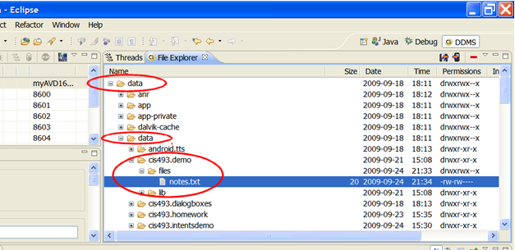
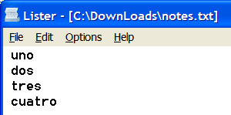
Android Persistency - Files
Android Files
File is stored in the phone’s memory under: /data/data/app/files
Image of the file
pulled from the
device

Slide 26
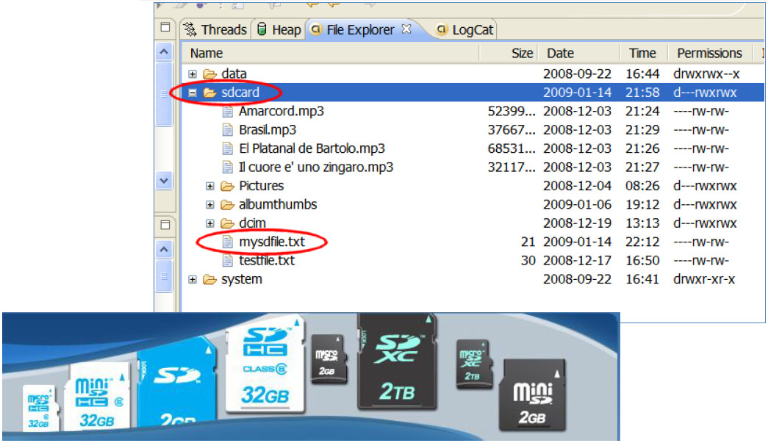
Android Persistency - Files
Android Files
Example 4 - External Storage
Reading/Writing to the External Device’s SD card.
Storing data into the SD card has the obvious
advantage of a larger working space.

Slide 27
Android Persistency - Files
Android Files
Warning – Write to the Device’s SD Card
Since SDK1.6 it is necessary to request permission to write to the SD card. Add the following clause to your AndroidManifest.xml
<uses-permission android:name="android.permission.WRITE_EXTERNAL_STORAGE">
</uses-permission>

Slide 28
Android Persistency - Files
Android Files
Example 4 - Reading/Writing to the Device’s SD card.
<?xml version="1.0" encoding="utf-8"?>
<LinearLayout
xmlns:android=http://schemas.android.com/apk/res/android
android:id="@+id/widget28"
android:layout_width="fill_parent"
android:layout_height="fill_parent"
android:background="#ff0000ff"
android:orientation="vertical"
>
<EditText
android:id="@+id/txtData"
android:layout_width="fill_parent“

Slide 29
Android Persistency - Files
Android Files
Example 4 - Reading/Writing to the Device’s SD card.
android:layout_height="180px"
android:text="Enter some data here ..."
android:textSize="18sp" />
<Button
android:id="@+id/btnWriteSDFile"
android:layout_width="143px"
android:layout_height="44px"
android:text="1. Write SD File" />
<Button
android:id="@+id/btnClearScreen"
android:layout_width="141px"
android:layout_height="42px“

Slide 30
Android Persistency - Files
Android Files
Example 4 - Reading/Writing to the Device’s SD card.
android:text="2. Clear Screen" />
<Button
android:id="@+id/btnReadSDFile"
android:layout_width="140px"
android:layout_height="42px"
android:text="3. Read SD File" />
<Button
android:id="@+id/btnClose"
android:layout_width="141px"
android:layout_height="43px"
android:text="4. Close" />
</LinearLayout>

Slide 31
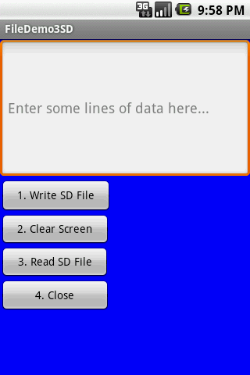
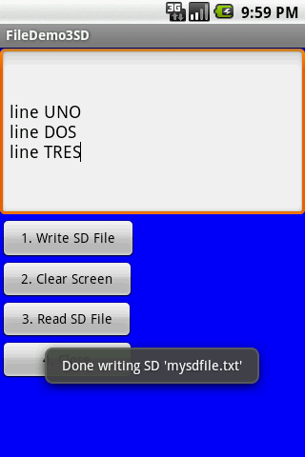

Android Persistency - Files
Android Files
Example 4 - Reading/Writing to the Device’s SD card.

Slide 32
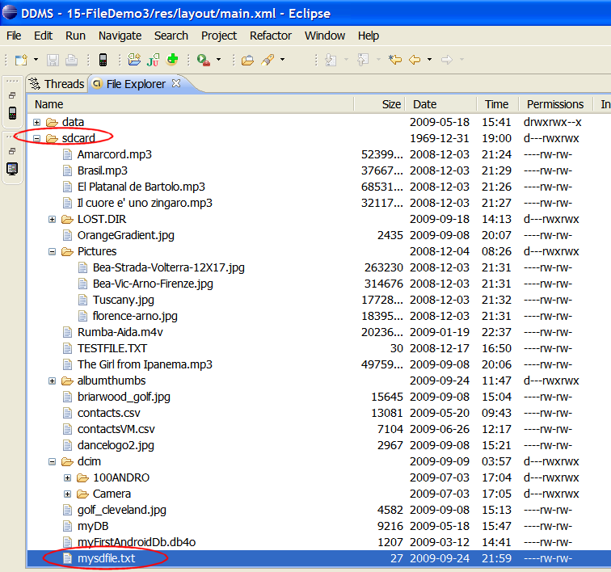
Android Persistency - Files
Android Files
Example 4 - Reading/Writing to the Device’s SD card.
Using DDMS File Explorer panel to inspect the SD card.

Slide 33
Android Persistency - Files
Android Files
Example 4 - Reading/Writing to the Device’s SD card.
package cis493.filedemo;
import java.io.*;
import android.app.Activity;
import android.os.Bundle;
import android.view.*;
import android.view.View.OnClickListener;
import android.widget.*;
public class FileDemo3SD extends Activity {
// GUI controls
EditTexttxtData;
Button btnWriteSDFile;
Button btnReadSDFile;

Slide 34
Android Persistency - Files
Android Files
Example 4 - Reading/Writing to the Device’s SD card.
Button btnClearScreen;
Button btnClose;
@Override
public void onCreate(Bundle savedInstanceState) {
super.onCreate(savedInstanceState);
setContentView(R.layout.main);
// bind GUI elements with local controls
txtData= (EditText) findViewById(R.id.txtData);
txtData.setHint("Enter some lines of data here...");
btnWriteSDFile= (Button) findViewById(R.id.btnWriteSDFile);
btnWriteSDFile.setOnClickListener(newOnClickListener() {
@Override

Slide 35
Android Persistency - Files
Android Files
Example 4 - Reading/Writing to the Device’s SD card.
public void onClick(View v) {
// write on SD card file data from the text box
try{
File myFile= newFile("/sdcard/mysdfile.txt");
myFile.createNewFile();
FileOutputStreamfOut= newFileOutputStream(myFile);
OutputStreamWritermyOutWriter= newOutputStreamWriter(fOut);
myOutWriter.append(txtData.getText());
myOutWriter.close();
fOut.close();
Toast.makeText(getBaseContext(),
"Done writing SD 'mysdfile.txt'",

Slide 36
Android Persistency - Files
Android Files
Example 4 - Reading/Writing to the Device’s SD card.
Toast.LENGTH_SHORT).show();
} catch(Exception e) {
} Toast.makeText(getBaseContext(),
e.getMessage(), Toast.LENGTH_SHORT).show();
}// onClick
}); // btnWriteSDFile
btnReadSDFile= (Button) findViewById(R.id.btnReadSDFile);
btnReadSDFile.setOnClickListener(newOnClickListener() {
@Override
publicvoidonClick(View v) {
// write on SD card file data from the text box

Slide 37
Android Persistency - Files
Android Files
Example 4 - Reading/Writing to the Device’s SD card.
try{
File myFile= newFile("/sdcard/mysdfile.txt");
FileInputStreamfIn= newFileInputStream(myFile);
BufferedReadermyReader= newBufferedReader(newInputStreamReader(fIn));
String aDataRow= "";
String aBuffer= "";
while((aDataRow= myReader.readLine()) != null) {
aBuffer+= aDataRow+ "\n";
}
txtData.setText(aBuffer);
myReader.close();

Slide 38
Android Persistency - Files
Android Files
Example 4 - Reading/Writing to the Device’s SD card.
Toast.makeText(getBaseContext(),
"Done reading SD 'mysdfile.txt'", 1).show();
} catch(Exception e) {
Toast.makeText(getBaseContext(), e.getMessage(), 1).show();
}
}// onClick
}); // btnReadSDFile
btnClearScreen= (Button) findViewById(R.id.btnClearScreen);
btnClearScreen.setOnClickListener(newOnClickListener() {
@Override
publicvoidonClick(View v) {
// clear text box

Slide 39
Android Persistency - Files
Android Files
Example 4 - Reading/Writing to the Device’s SD card.
txtData.setText("");
}
}); // btnClearScreen
btnClose= (Button) findViewById(R.id.btnClose);
btnClose.setOnClickListener(newOnClickListener() {
@Override
publicvoidonClick(View v) {
// clear text box
finish();}
}); // btnClose
}// onCreate
}// class

Slide 40
Android Persistency - Files
Android Files
Example 4 - Reading/Writing to the Device’s SD card. You may also use the Scanner/PrintWriter classes, as suggested below:
private void testScannerFiles(){
// Add to manifest the following permission request
// <uses-permission android:name="android.permission.WRITE_EXTERNAL_STORAGE" />
try{
String SDcardPath= Environment.getExternalStorageDirectory().getPath();
String mySDFileName= SDcardPath+ "/"+ "mysdfiletest.txt";
tvMessage.setText("Writing to: "+ mySDFileName);
PrintWriteroutfile= new PrintWriter( newFileWriter(mySDFileName) );
outfile.println("Hola Android");

Slide 41
Android Persistency - Files
Android Files
Example 4 - Reading/Writing to the Device’s SD card. You may also use the Scanner/PrintWriterclasses, as suggested below:
outfile.println("Adios Android");
outfile.println(newDate().toString());
outfile.close(); // read SD-file,showrecords.
Scanner infile= newScanner(newFileReader(mySDFileName));
String inString= "\n\nReadingfrom: "+ mySDFileName+ "\n";
while(infile.hasNextLine()) {
inString+= infile.nextLine() + "\n“;}
tvMessage.append(inString);
infile.close();} catch(FileNotFoundExceptione) {
tvMessage.setText( "Error: "+ e.getMessage());
} catch(IOExceptione) {
tvMessage.setText( "Error: "+ e.getMessage());}}

Slide 42
Android Persistency - Files
Android Files
Example 5 - Some more ideas on using the Scanner/Print Writer classes.
// writing
FileOutputStreamfos= openFileOutput("XYZ", Context.MODE_PRIVATE);
PrintWriteroutfile= newPrintWriter( fos);
outfile.println("HolaAndroid");
outfile.close();
// reading
InputStreamis = openFileInput("XYZ");
Scanner infile= newScanner(is);
String inString= "";
while(infile.hasNextLine()) {
inString= infile.nextLine();}

